Slide 1
Modern Database Systems
BITS Pilani
Prof. Ashish Narang
CSIS

Slide 2
BITS Pilani
<SSZG507, Modern Database Systems> Lecture No. 3

Slide 3
Contents
Need for Distributed Databases
Centralized vs Distributed Database Systems
Distributed Database Architecture
Types of Distributed Database Systems
Challenges in Distributed Database Systems
Data Partitioning and Fragmentation
Data Allocation
Data Replication
Comparison of Replication Strategies

Slide 4
Need for Distributed Databases
Modern applications may operate across multiple geographical locations and computing sites.
A distributed computing system consists of multiple interconnected sites or nodes that cooperate to perform tasks.
Instead of keeping all data and processing at a single location, data and computation can be distributed across networked nodes.
Distributed data management can provide:
Improved availability and reliability
Better performance through data localization
Support for geographically distributed applications
Easier expansion and scalability
These requirements motivate the move from a centralized database system to a Distributed Database System (DDBS).

Slide 5
What is a Distributed Database?
Distributed Database (DDB)
A collection of multiple logically interrelated databases distributed over a computer network.
Data may be physically stored at different sites or nodes, but it is logically related.
Each site may perform local processing and may also participate in global transactions.
To users, the distributed data should ideally appear as a single integrated database. Distributed Database Management System (DDBMS)
Software that manages the distributed database and coordinates access across different sites.
Provides mechanisms for data access, communication, transaction management, and coordination among participating sites.

Slide 6
Characteristics of a Distributed Database System
A Distributed Database System typically has the following characteristics:
Data Distribution – Data is physically stored across multiple sites connected through a
network.
Logical Integration – Distributed data forms a logically related and integrated database.
Local Autonomy – Individual sites may have some control over their local data and
operations.
Network Communication – Sites communicate and exchange data through a communication network.
Distributed Processing – Queries and transactions may involve data stored at multiple sites.
Distribution Transparency – Users should ideally access data without needing to know its
physical location.
Reliability & Availability – Distribution can allow continued operation even when some sites or communication links fail.

Slide 7
Advantages of Distributed Databases
Distributed database systems offer several advantages:
Improved Reliability and Availability
Failure of one site does not necessarily make the entire database inaccessible.
Improved Performance
Data can be stored close to where it is most frequently used, reducing data communication and access time.
Local Control of Data
Individual sites can retain a degree of control over their locally stored data.
Modular Growth
New sites and computing resources can be added as organizational requirements grow.
Reduced Communication Overhead
Frequently accessed data can be processed locally instead of repeatedly accessing a remote
central database.
Support for Distributed Organizations
The database structure can naturally reflect organizations operating across multiple geographical locations.

Slide 8
Centralized vs Distributed Database Systems
Centralized Database System | Distributed Database System
Data primarily stored at a single site | Data stored across multiple sites
Centralized processing and control | Processing may occur at multiple sites
Simpler administration and coordination | Requires coordination among distributed sites
Central site can become a single point of failure | Failure of one site may allow other sites to continue
Scaling often requires increasing central resources | Supports growth by adding sites/resources
Remote users depend heavily on network access to central site | Data can be located closer to users
Lower distribution-management complexity | Higher communication and consistency complexity

Slide 9
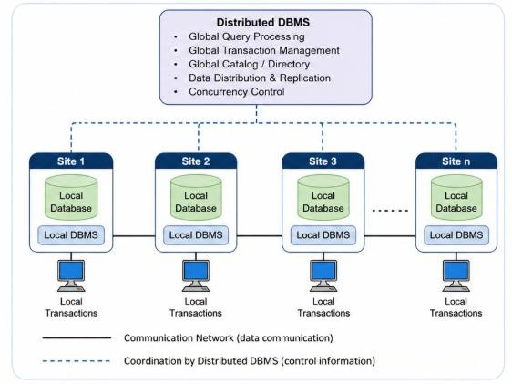
Distributed Database Architecture: Basic View
A Distributed Database System consists of multiple interconnected sites, where each site may contain:
Local Database – Stores data assigned to that site.
Local DBMS – Manages local data and local transactions.
Communication Network – Connects participating database sites.
Distributed DBMS Functions – Coordinate access to data across multiple sites.
Local Transactions – Access data stored at a single site.
Global Transactions – Access data stored at more than
one site.

Slide 10
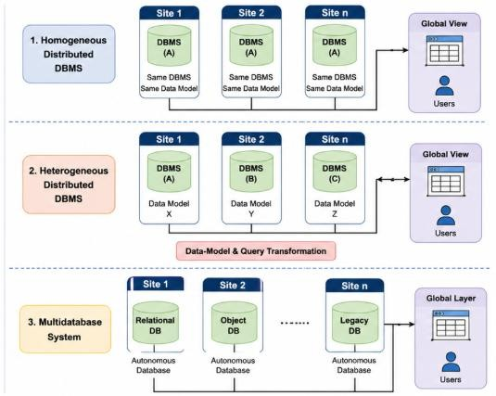
Types of Distributed Database Systems
Distributed database systems can be classified based on the similarity of DBMSs, data models, and degree of site autonomy.
Homogeneous Distributed DBMS
All sites use the same DBMS software.
Sites typically use the same data model.
Integration and communication are relatively easier.
Appears more naturally as a single distributed database system.
Heterogeneous Distributed DBMS
Sites may use different DBMS products.
Different sites may use different data models or schemas.
Requires mechanisms for data-model and query transformation.
Integration and coordination are more complex.
Multidatabase System
Integrates multiple pre-existing autonomous databases.
Individual databases may retain significant local autonomy.
A global layer provides access across participating databases.

Slide 11
Challenges in Distributed Database Systems
Distributing data across multiple sites introduces several challenges:
Network Communication – Data and control messages must travel between sites.
Site & Network Failures – Individual nodes or communication links may become unavailable.
Data Consistency – Multiple copies of data must remain appropriately synchronized.
Distributed Transaction Management – Transactions involving multiple sites require coordination.
Concurrency Control – Concurrent operations at different sites must preserve database correctness.
Distributed Query Processing – Accessing data from multiple sites can increase communication and
processing cost.
Security – Data and communication must be protected across multiple locations.
System Complexity – Administration, monitoring and recovery become more difficult than in centralized systems.

Slide 12
Data Partitioning in Distributed Databases
Data Partitioning (Fragmentation) divides a database relation into smaller fragments that can be stored at different sites.
Why Partition Data?
Place data closer to where it is frequently accessed
Reduce unnecessary data communication
Enable parallel processing across sites
Improve locality of reference
Support distribution according to organizational requirements
Main Types of Fragmentation
Horizontal Fragmentation: Divides a relation into subsets of rows (tuples).
Vertical Fragmentation: Divides a relation into subsets of columns (attributes).
Mixed/Hybrid Fragmentation: Combines horizontal and vertical fragmentation.

Slide 13
Horizontal Fragmentation
Horizontal Fragmentation divides a relation into subsets of tuples (rows) based on selection conditions.
How Does It Work?
Each fragment contains a subset of rows from the original relation.
Fragments generally retain the same attributes as
the original relation.
Selection conditions determine which tuples belong to each fragment.
Different fragments can be allocated to different sites.
Consider:
EMPLOYEE (Emp_ID, Name,
Department, Location, Salary)
Delhi Fragment EMPDelhi=σ_{Location=′Delhi′}(EMPLOYEE) Mumbai Fragment EMPMumbai=σ_{Location=′Mumbai′}(EMPLOYEE) Reconstruction
The original relation can be reconstructed using UNION:
EMPLOYEE=EMPDelhi ∪ EMPMumbai

Slide 14
Primary and Derived Horizontal Fragmentation
Horizontal fragmentation can be further classified into:
Primary Horizontal Fragmentation
Performed using predicates defined on the relation itself.
Tuples are grouped according to conditions on the relation’s own attributes.
Example:
EMPDelhi=σ_{Location=′Delhi′}(EMPLOYEE)
Derived Horizontal Fragmentation
Fragmentation of one relation is based on the fragmentation of another related relation.
Commonly used when two relations are connected through a relationship.
Helps place related data at the same site.
Example:
If DEPARTMENT is fragmented by location, EMPLOYEE can be fragmented according to the corresponding DEPARTMENT fragments.

Slide 15
Common Clauses Used with SELECT
Vertical Fragmentation divides a relation into
subsets of attributes (columns). How Does It Work?
Each fragment contains selected attributes of the original relation.
Attributes frequently accessed together can be
placed in the same fragment.
The primary key (or tuple identifier) is included in each vertical fragment.
Different fragments may be allocated to different
sites based on their usage.
Consider:
EMPLOYEE (Emp_ID, Name, Department,
Location, Salary)
Fragment 1 – General Information
^{EMP1=π}Emp_ID, Name, Department^{(EMPLOYEE)}
Fragment 2 – Payroll Information
^{EMP2=π}Emp_ID, Salary, Contact^{(EMPLOYEE)}
Reconstruction
The original relation can be reconstructed using a JOIN on the common key: EMPLOYEE=EMP1⋈Emp_IDEMP2

Slide 16
Mixed (Hybrid) Fragmentation
Mixed Fragmentation combines horizontal and vertical fragmentation to distribute data according to application requirements.
How Does It Work?
A relation may be fragmented:
Horizontally first, then vertically, or
Vertically first, then horizontally Example
Consider:
EMPLOYEE (Emp_ID, Name, Department, Location, Salary) Step 1 – Horizontal Fragmentation by Location
EMPDelhi=σ_{Location=′Delhi′}(EMPLOYEE)
EMPMumbai=σ_{Location=′Mumbai′}(EMPLOYEE)
Step 2 – Vertical Fragmentation of Delhi Data
EMPDelhi−General=π_{Emp_ID,Name,Department}(EMPDelhi)
EMPDelhi−Payroll=π_{Emp_ID,Salary}(EMPDelhi)

Slide 17
Data Allocation in Distributed Databases
After fragmentation, the next decision is where each fragment should be stored.
Data Allocation refers to assigning database fragments to different sites in a distributed system.
Allocation Strategies
Non-Replicated (Partitioned) Allocation
Each fragment is stored at only one site.
No duplicate copies are maintained.
Fully Replicated Allocation
A complete copy of the database is stored at every site.
Provides high availability but increases update overhead.
Partially Replicated Allocation
Selected fragments are stored at multiple sites.
Other fragments may exist at only one site.
Provides a balance between availability and update cost.

Slide 18
Data Replication in Distributed Databases
Data Replication involves maintaining multiple copies of the same data at different sites in a
distributed database system.
Why Replicate Data?
Improved Availability – Data may remain accessible even if one site fails.
Improved Reliability – Multiple copies reduce dependence on a single site.
Faster Read Access – Users can access a nearby replica.
Reduced Communication Cost – Frequently accessed data can be available locally.
Support for Parallel Reads – Read requests can be served by different replicas.

Slide 19
Replication Trade-off
Benefits
Higher availability
Better read performance
Greater fault tolerance
Costs
Additional storage
Increased update overhead
Maintaining consistency among replicas

Slide 20
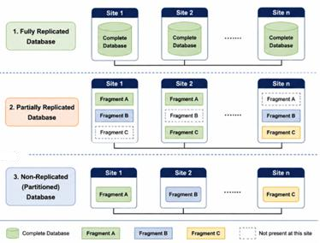
Degrees of Data Replication
Depending on the number of copies maintained, a distributed database can use different degrees of replication.
Fully Replicated Database
A complete copy of the database is stored at every site.
Provides high availability and reliability.
Read operations can often be performed locally.
Updates must be propagated to all replicas.
Partially Replicated Database
Only selected fragments are replicated.
Different fragments may have different numbers of
copies.
Balances availability, performance, storage, and update cost.
Non-Replicated (Partitioned) Database
Each fragment is stored at one site only.
Lower storage and update overhead.
Availability depends on the site containing the required fragment.

Slide 21
Synchronous vs Asynchronous Replication
When data is replicated, an important decision is when updates are propagated to replicas.
Synchronous Replication | Asynchronous Replication
Update is propagated before the operation is considered complete | Primary update can complete before replicas are updated
Replicas remain closely synchronized | Replicas may temporarily contain older data
Stronger consistency between copies | Temporary inconsistency may occur
Higher write latency | Lower write latency
More sensitive to slow/unavailable replicas | Better tolerance of network delays
Suitable when up-to-date replicas are critical | Suitable when performance and geographic distribution are important

Slide 22
Leader–Follower Replication
In Leader–Follower Replication, one replica is designated as the Leader
(Primary) and other replicas act as Followers (Replicas/Secondaries).
How It Works
Writes are sent to the Leader.
Leader updates its local database.
Leader sends the changes to its Followers.
Followers apply the changes to their local copies.
Reads may be served by the leader or followers, depending on system configuration.
Characteristics
Provides a single point for coordinating writes.
Followers maintain copies of the leader's data.
Replication may be synchronous or asynchronous.
Followers can help scale read workloads.
If the leader fails, a follower may be promoted as the new leader.
Asynchronous followers may return stale data because of replication
lag.

Slide 23
Multi-Leader Replication
How It Works
Major Challenge Write Conflicts Leader A: X → 100 Leader B: X → 200
Multiple nodes act as Leaders.
Clients can write to different leaders.
Each leader applies its local writes.
Leaders replicate their changes to other leaders.
Conflicting concurrent updates may require conflict detection and resolution.
Where is it Useful?
Multi-datacenter deployments
Applications with users distributed across geographical regions
Environments requiring local write processing
Systems that may need to continue accepting writes despite
connectivity problems between sites

Slide 24
Leaderless Replication
In Leaderless Replication, there is no designated leader for handling writes.
How It Works
Clients can send writes to multiple replicas directly.
A write is considered successful after a required number of replicas acknowledge it.
Reads may also query multiple replicas.
Differences between replicas may be detected and repaired.
The system continues to operate without depending on a single leader.
Quorum-Based Approach
Let:
N = Number of replicas
W = Number of replicas that must acknowledge a write
R = Number of replicas contacted for a read
A commonly discussed quorum condition is:
W+R>N
This creates an overlap between the replicas involved in reads and writes.
Source: https://medium.com/@matheesha27/transaction-states-acid-properties-in-a-dbms-94197273a14a

Slide 25
Comparing Replication Strategies
Aspect | Leader–Follower | Multi-Leader | Leaderless
Write coordination | Single leader | Multiple leaders | No designated leader
Writes accepted by | Leader | Any leader | Multiple replicas
Read scalability | High through followers | High | High
Write locality | Limited by leader location | High | High
Conflict possibility | Relatively lower | Higher | Higher
Failure handling | Leader failover required | Other leaders may continue | No leader failover required
Main challenge | Leader failure / replication lag | Write conflicts | Replica divergence / coordination
Typical use | General-purpose replication | Multi-region systems | Highly available distributed systems

Slide 26
Summary
Need for Distributed Databases
Availability, performance, scalability and geographical distribution
Centralized vs Distributed Systems
Distribution provides locality and availability at the cost of increased coordination
Distributed Database Architecture
Multiple interconnected sites with local and global operations
Homogeneous, heterogeneous and multidatabase environments
Challenges in Distributed Systems
Communication, failures, consistency, concurrency and coordination
Data Partitioning / Fragmentation
Horizontal fragmentation
Primary & derived horizontal fragmentation
Vertical fragmentation
Mixed fragmentation
Data Allocation & Replication
Non-replicated, partially replicated and fully replicated data
Synchronous vs asynchronous replication
Leader–Follower, Multi-Leader and Leaderless replication

Slide 27
Thank You

